Slide 1
Chapter 3
DATA MODELING USING ENTITY

Slide 2
CONCEPTUAL DATA MODELING
Conceptual modeling is a very important phase in designing a successful database application.
The term database application refers to a particular database and the associated programs that implement the database queries and updates
For example, a BANK database application that keeps track of customer accounts would include programs that implement database updates corresponding to customer deposits and withdrawals. These programs would provide user-friendly graphical user interfaces (GUIs) utilizing forms and menus for the end users of the application—the bank customers or bank tellers in this example
Hence, a major part of the database application will require the design, implementation, and testing of these application programs

Slide 3
Traditionally, the design and testing of application programs has been considered to be part of software engineering rather than database design.
In many software design tools, the database design methodologies and software engineering methodologies are intertwined since these activities are strongly related.

Slide 4
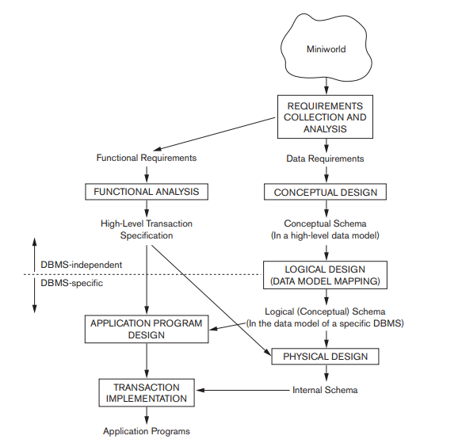
Using High-Level Conceptual Data Models for Database Design

Slide 5
The first step shown is requirements collection and analysis. During this step, the database designers interview prospective database users to understand and document their data requirements.
The result of this step is a concisely written set of users’ requirements. These requirements should be specified in as detailed and complete a form as possible.
In parallel with specifying the data requirements, it is useful to specify the known functional requirements of the application. These consist of the user defined operations (or transactions) that will be applied to the database, including both retrievals and updates.
In software design, it is common to use data flow diagrams, sequence diagrams, scenarios, and other techniques to specify functional requirements. Once the requirements have been collected and analyzed, the next step is to create a conceptual schema for the database, using a high-level conceptual data model. This step is called conceptual design.

Slide 6
The conceptual schema is a concise description of the data requirements of the users and includes detailed descriptions of the entity types, relationships, and constraints; these are expressed using the concepts provided by the high-level data model.
Because these concepts do not include implementation details, they are usually easier to understand and can be used to communicate with nontechnical users.
The high-level conceptual schema can also be used as a reference to ensure that all users’ data requirements are met and that the requirements do not conflict.
This approach enables database designers to concentrate on specifying the properties of the data, without being concerned with storage and implementation details, which makes it is easier to create a good conceptual database design. During or after the conceptual schema design, the basic data model operations can be used to specify the high-level user queries and operations identified during functional analysis. This also serves to confirm that the conceptual schema meets all the identified functional requirements. Modifications to the conceptual schema can be introduced if some functional requirements cannot be specified using the initial schema.

Slide 7
During or after the conceptual schema design, the basic data model operations can be used to specify the high-level user queries and operations identified during functional analysis.
This also serves to confirm that the conceptual schema meets all the identified functional requirements.
Modifications to the conceptual schema can be introduced if some functional requirements cannot be specified using the initial schema.
The next step in database design is the actual implementation of the database, using a commercial DBMS.
Most current commercial DBMSs use an implementation data model—such as the relational (SQL) model—so the conceptual schema is transformed from the high-level data model into the implementation data model.
This step is called logical design or data model mapping; its result is a database schema in the implementation data model of the DBMS. Data model mapping is often automated or semiautomated within the database design tools.

Slide 8
The last step is the physical design phase, during which the internal storage structures, file organizations, indexes, access paths, and physical design parameters for the database files are specified.
In parallel with these activities, application programs are designed and implemented as database transactions corresponding to the high-level transaction specifications.
A Sample Database Application:
In this section we describe a sample database application, called COMPANY, which serves to illustrate the basic ER model concepts and their use in schema design.
We list the data requirements for the database here, and then create its conceptual schema step-by-step as we introduce the modeling concepts of the ER model.

Slide 9
The COMPANY database keeps track of a company’s employees, departments, and projects.
A department controls a number of projects, each of which has a unique name, a unique number, and a single location.
The database will store each employee’s name, Social Security number,2 address, salary, sex (gender), and birth date. An employee is assigned to one department, but may work on several projects, which are not necessarily controlled by the same department. It is required to keep track of the current number of hours per week that an employee works on each project, as well as the direct supervisor of each employee (who is another employee).
The database will keep track of the dependents of each employee for insurance purposes, including each dependent’s first name, sex, birth date, and relationship to the employee.

Slide 10
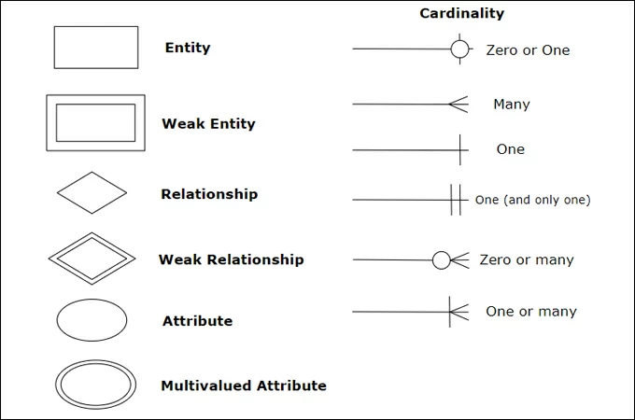
ER MODEL

Slide 11
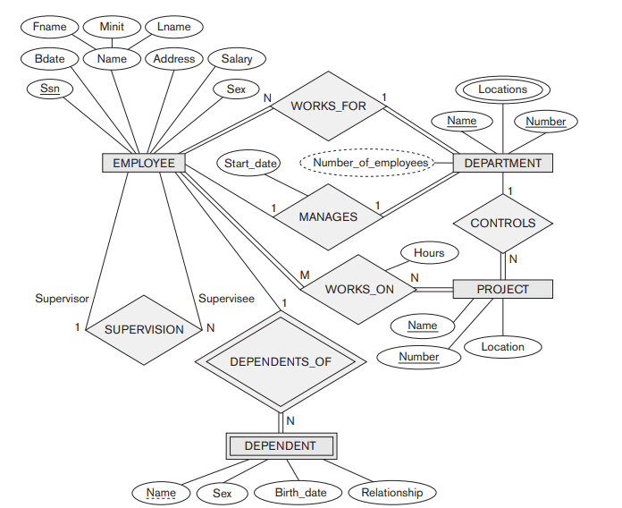

Slide 12
ENTITY AND ATTRIBUTE
The basic concept that the ER model represents is an entity, which is a thing or object in the real world with an independent existence.
An entity may be an object with a physical existence (for example, a particular person, car, house, or employee) or it may be an object with a conceptual existence (for instance, a company, a job, or a university course).
Each entity has attributes—the particular properties that describe it.
The attribute values that describe each entity become a major part of the data stored in the database.

Slide 13
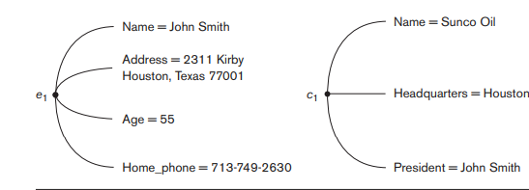
Figure shows two entities and the values of their attributes.
The EMPLOYEE entity e1 has four attributes: Name, Address, Age, and Home_phone; their values are ‘John Smith,’ ‘2311 Kirby, Houston, Texas 77001’, ‘55’, and ‘713-749-2630’, respectively.
The COMPANY entity c1 has three attributes: Name, Headquarters, and President; their values are ‘Sunco Oil’, ‘Houston’, and ‘John Smith’, respectively.

Slide 14
Several types of attributes occur in the ER model:
Simple versus composite,
Single valued versus multivalued, and
Stored versus derived

Slide 15
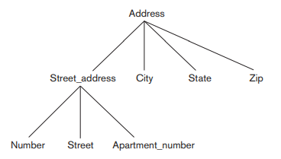
Composite versus Simple (Atomic) Attributes
Composite attributes can be divided into smaller subparts, which represent more basic attributes with independent meanings

Slide 16
For example, the Address attribute of the EMPLOYEE entity can be subdivided into Street_address, City, State, and Zip, 3 with the values ‘2311 Kirby’, ‘Houston’, ‘Texas’, and ‘77001’.
Attributes that are not divisible are called simple or atomic attributes.
Composite attributes can form a hierarchy; for example, Street_address can be further subdivided into three simple component attributes: Number, Street, and Apartment_number, .
The value of a composite attribute is the concatenation of the values of its component simple attributes.

Slide 17
Single-Valued versus Multivalued Attributes
Most attributes have a single value for a particular entity; such attributes are called single-valued.
For example, Age is a single-valued attribute of a person.
In some cases an attribute can have a set of values for the same entity—for instance, a Colors attribute for a car, or a College_degrees attribute for a person.
Cars with one color have a single value, whereas two cars have two color values.

Slide 18
Similarly, one person may not have any college degrees, another person may have one, and a third person may have two or more degrees; therefore, different people can have different numbers of values for the College_degrees attribute.
Such attributes are called multivalued.
A multivalued attribute may have lower and upper bounds to constrain the number of values allowed for each individual entity.
For example, the Colors attribute of a car may be restricted to have between one and two values, if we assume that a car can have two colors at most.

Slide 19
Stored versus Derived Attributes
In some cases, two (or more) attribute values are related—for example, the Age and Birth_date attributes of a person. For a particular person entity, the value of Age can be determined from the current (today’s) date and the value of that person’s Birth_date.
The Age attribute is hence called a derived attribute and is said to be derivable from the Birth_date attribute, which is called a stored attribute.
Some attribute values can be derived from related entities; for example, an attribute Number_of_employees of a DEPARTMENT entity can be derived by counting the number of employees related to (working for) that department

Slide 20
NULL Values
In some cases, a particular entity may not have an applicable value for an attribute.
For example, the Apartment_number attribute of an address applies only to addresses that are in apartment buildings and not to other types of residences, such as single-family homes.
Similarly, a College_degrees attribute applies only to people with college degrees. For such situations, a special value called NULL is created.
An address of a single-family home would have NULL for its Apartment_number attribute, and a person with no college degree would have NULL for College_degrees.
NULL can also be used if we do not know the value of an attribute for a particular entity—
The unknown category of NULL can be further classified into two cases. The first case arises when it is known that the attribute value exists but is missing—for instance, if the Height attribute of a person is listed as NULL. The second case arises when it is not known whether the attribute value exists—for example, if the Home_phone attribute of a person is NULL.

Slide 21
Complex Attributes
Notice that, in general, composite and multivalued attributes can be nested arbitrarily.
We can represent arbitrary nesting by grouping components of a composite attribute between parentheses ( ) and separating the components with commas, and by displaying multivalued attributes between braces { }.
Such attributes are called complex attributes. For example, if a person can have more than one residence and each residence can have a single address and multiple phones, an attribute Address_phone for a person can be specified as given below.
{Address_phone( {Phone(Area_code,Phone_number)},Address(Street_address (Number,Street,Apartment_number),City,State,Zip) )}

Slide 22
Entity Types, Entity Sets, Keys, and Value Sets
Entity Types and Entity Sets: A database usually contains groups of entities that are similar.
For example, a company employing hundreds of employees may want to store similar information concerning each of the employees.
These employee entities share the same attributes, but each entity has its own value(s) for each attribute.
An entity type defines a collection (or set) of entities that have the same attributes.
Each entity type in the database is described by its name and attributes.

Slide 23
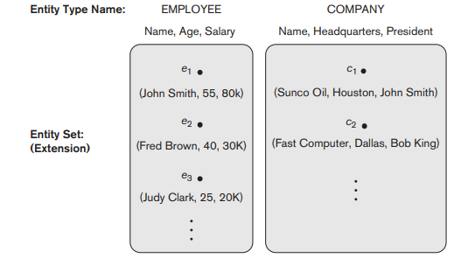
An entity type describes the schema or intension for a set of entities that share the same structure.
The collection of entities of a particular entity type is grouped into an entity set, which is also called the extension of the entity type.

Slide 24
Key attribute
An entity type usually has one or more attributes whose values are distinct for each individual entity in the entity set. Such an attribute is called a key attribute, and its values can be used to identify each entity uniquely.
Types of Keys:
Primary Key
Candidate Key
Super Key
Foreign Key
Alternate Key
Composite Key

Slide 25
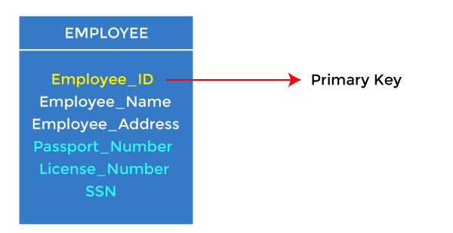
Primary Key
It is the first key used to identify one and only one instance of an entity uniquely. An entity can contain multiple keys, as we saw in the PERSON table. The key which is most suitable from those lists becomes a primary key.
In the EMPLOYEE table, ID can be the primary key since it is unique for each employee. In the EMPLOYEE table, we can even select License_Number and Passport_Number as primary keys since they are also unique.
For each entity, the primary key selection is based on requirements and developers.

Slide 26
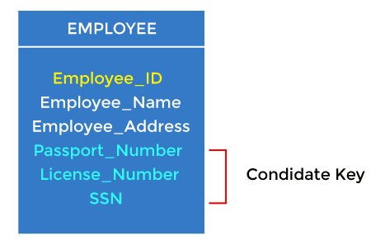
Candidate key
A candidate key is an attribute or set of attributes that can uniquely identified.
Except for the primary key, the remaining attributes are considered a candidate key. The candidate keys are as strong as the primary key.
For example: In the EMPLOYEE table, id is best suited for the primary key. The rest of the attributes, like SSN, Passport_Number, License_Number, etc., are considered a candidate key.
Candidate Key

Slide 27
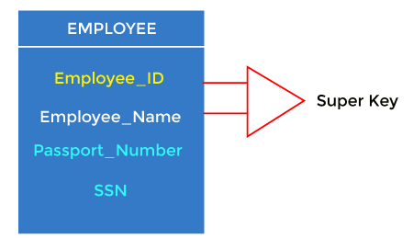
Super Key
Super key is an attribute set that can uniquely identify a tuple. A super key is a superset of a candidate key.
For example: In the above EMPLOYEE table, for(EMPLOEE_ID, EMPLOYEE_NAME), the name of two employees can be the same, but their EMPLYEE_ID can't be the same. Hence, this combination can also be a key.
The super key would be EMPLOYEE-ID (EMPLOYEE_ID, EMPLOYEE-NAME).

Slide 28
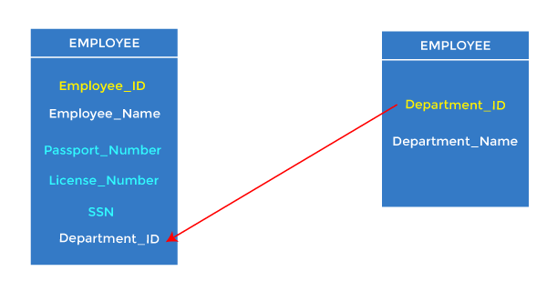
Foreign key
Foreign keys are the column of the table used to point to the primary key of another table.
Every employee works in a specific department in a company, and employee and department are two different entities. So we can't store the department's information in the employee table. That's why we link these two tables through the primary key of one table.
We add the primary key of the DEPARTMENT table, Department_Id, as a new attribute in the EMPLOYEE table.
In the EMPLOYEE table, Department_Id is the foreign key, and both the tables are related.

Slide 29
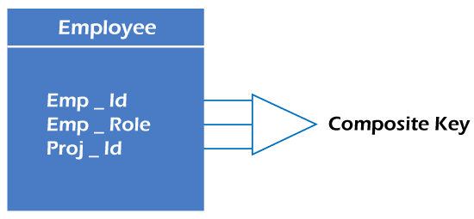
Composite key
Whenever a primary key consists of more than one attribute, it is known as a composite key. This key is also known as Concatenated Key.
For example, in employee relations, we assume that an employee may be assigned multiple 06 roles, and an employee may work on multiple projects simultaneously. So the primary key will be composed of all three attributes, namely Emp_ID, Emp_role, and Proj_ID in combination. So these attributes act as a composite key since the primary key comprises more than one attribute.

Slide 30
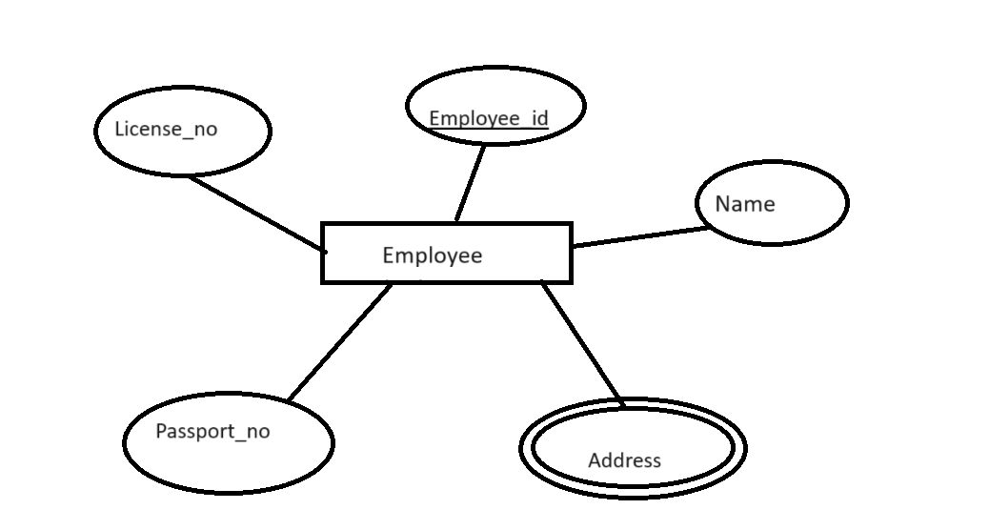
ER Diagram with Primary key and Composite key
Since Employee_id is primary key it is under lined in the ER Diagram
Since Address is the combination of simple attributes like house_no, street, location the address is the composite attribute and marked with double oval

Slide 31
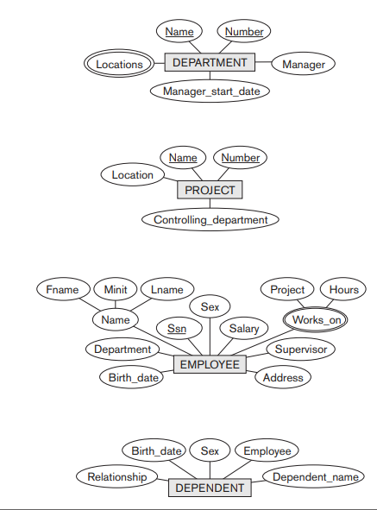
Relationships , Relationship types, Roles and Structural constraints

Slide 32
Figure Preliminary design of entity types for the COMPANY database. Some of the shown attributes will be refined into relationships.
In Figure there are several implicit relationships among the various entity types.
In fact, whenever an attribute of one entity type refers to another entity type, some relationship exists.
For example, the attribute Manager of DEPARTMENT refers to an employee who manages the department; the attribute Controlling_department of PROJECT refers to the department that controls the project; the attribute Supervisor of EMPLOYEE refers to another employee (the one who supervises this employee); the attribute Department of EMPLOYEE refers to the department for which the employee works; and so on.
In the ER model, these references should not be represented as attributes but as relationships .
In the initial design of entity types, relationships are typically captured in the form of attributes. As the design is refined, these attributes get converted into relationships between entity types.

Slide 33
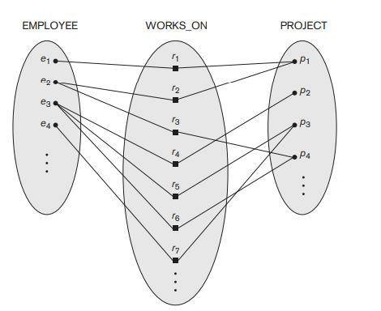
Relationship Types, Sets, and Instances
Some instances in the WORKS_ON relationship set, which represents a relationship type WORKS_On between EMPLOYEE and Project.

Slide 34
A relationship type R among n entity types E1, E2, . . . , En defines a set of associations—or a relationship set—among entities from these entity types.
Similar to the case of entity types and entity sets, a relationship type and its corresponding relationship set are customarily referred to by the same name, R.
Mathematically, the relationship set R is a set of relationship instances ri, where each ri associates n individual entities (e1, e2, . . . , en), and each entity ej in ri is a member of entity set Ej , 1 ≤ j ≤ n. Hence, a relationship set is a mathematical relation on E1, E2, . . . , En; alternatively, it can be defined as a subset of the
Cartesian product of the entity sets E1 × E2 × . . . × En. Each of the entity types E1, E2, . . . , En is said to participate in the relationship type R; similarly, each of the individual entities e1, e2, . . . , en is said to participate in the relationship instance ri = (e1, e2, . . . , en).
Informally, each relationship instance ri in R is an association of entities, where the association includes exactly one entity from each participating entity type. Each such relationship instance ri represents the fact that the entities participating in ri are related in some way in the corresponding real world situation.

Slide 35
For example, consider a relationship type WORKS_FOR between the two entity types .EMPLOYEE and DEPARTMENT, which associates each employee with the department for which the employee works. Each relationship instance in the relationship set WORKS_FOR associates one EMPLOYEE entity and one DEPARTMENT entity. Figure illustrates this example, where each relationship instance ri is shown connected to the EMPLOYEE and DEPARTMENT entities that participate in ri. The employees e1, e3, and e6 work for department d1; the employees e2 and e4 work for department d2; and the employees e5 and e7 work for department d3

Slide 36
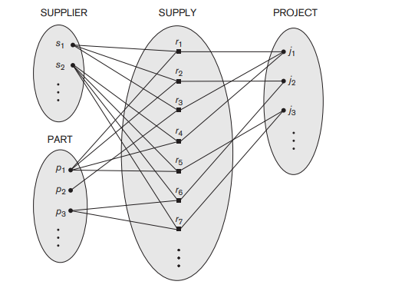
Relationship Degree, Role Names, and Recursive Relationships

Slide 37
Degree of a Relationship Type. The degree of a relationship type is the number of participating entity . There are 4 types of degrees of relationship based on the involved entities-
Unary relationship
Binary relationship
Ternary relationship
N-ary relationship
Unary Relationship
As the name suggests, in a unary relationship, only one entity is involved. There is only a single entity set, i.e., the association is between a single entity. Here, the degree of relationship is 1. The unary relationship is also known as a recursive relationship.

Slide 38
Example: Employee is managed by another Employee . So the degree of relationship is unary relationship
Employee
Managed by

Slide 39
Binary Relationship
In a binary relationship, there are two entities involved. There are two entities that are participating in the relationship. The degree of relationship is 2. This is the most common type of relationship.
Example- Each Indian citizen has their own Aadhar Card so we can say that citizen and Aadhar Card are two entities involved.
Citizen
Aadhar card

Slide 40
Ternary Relationship
In a ternary relationship, there are three entities involved. There are three entities that are participating in the relationship created. The degree of the relationship is 3. As in this relationship, the number of entities increases, it is a bit difficult to convert it to a relational table.
Related
Student
Department
Faculty

Slide 41
N-ary Relationship
This is a generalized form of a relationship when the n number of total entities are participating. When there is an n number of involved entities, we can say that they have an N-ary relationship. As there are many entities involved, it is hard to convert them to a relational table. It is an uncommon relationship that is not as widely used as a binary relationship. The degree of relationship is 'n'.
Student
Related
Department
Exam_cell
Placement_cell
Library

Slide 42
Relationships as Attributes:
In ER model, entities have attributes which can be of various types like single-valued, multi-valued, composite, simple, stored, derived and complex. But relationships can also have attributes associated to them.
Let us see the example how attributes associate with entity
One to One relationship:
One to many relationship:
Start date
1
1
Employee
Manages
Department
Start date
Employee
n
Works for
Department
1

Slide 43
Many to Many relationship:
Number of working hours
Employee
m
Works on
n
Project

Slide 44
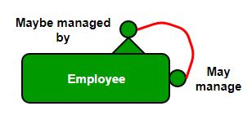
Recursive Relationship
A relationship between two entities of a similar entity type is called a recursive relationship. Here the same entity type participates more than once in a relationship type with a different role for each instance. In other words, a relationship has always been between occurrences in two different entities. However, the same entity can participate in the relationship. This is termed a recursive relationship.

Slide 45

Structural Constraints of Relationship
To understand Structural Constraints, we must take a look at Cardinality Ratios and Participation Constraints.
Cardinality Ratios of relationships : The entities are denoted by rectangle and relationships by diamond.
There are numbers (represented by M and N) written above the lines which connect relationships and entities. These are called cardinality ratios. These represent the maximum number of entities that can be associated with each other through relationship, R.

Slide 46
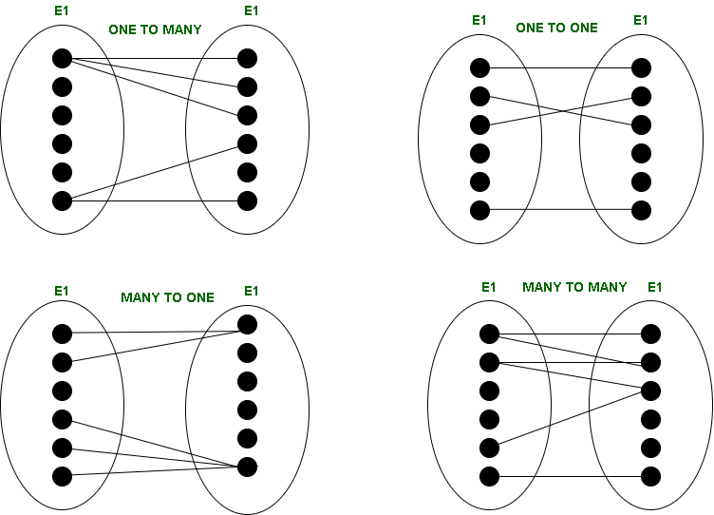
Types of Cardinality : There can be 4 types of cardinality –

Slide 47
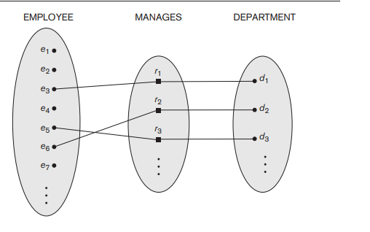
One-to-one (1:1) – When one entity in each entity set takes part at most once in the relationship, the cardinality is one-to-one.
2.One-to-many (1: N) – If entities in the first entity set take part in the relationship set at most once and entities in the second entity set take part many times (at least twice), the cardinality is said to be one-to-many.

Slide 48
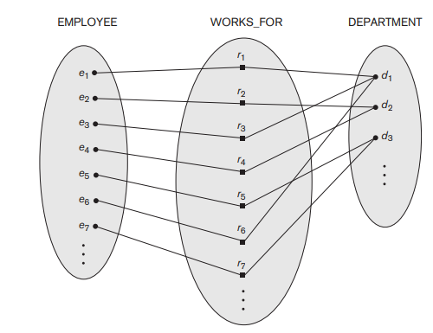
3.Many-to-one (N:1) – If entities in the first entity set take part in the relationship set many times (at least twice), while entities in the second entity set take part at most once, the cardinality is said to be many-to-one.
4.Many-to-many (M: N) – The cardinality is said to be many to many if entities in both the entity sets take part many times (at least twice) in the relationship set.

Slide 49
Participation Constraints and Existence Dependencies. The participation constraint specifies whether the existence of an entity depends on its being related to another entity via the relationship type. This constraint specifies the minimum number of relationship instances that each entity can participate in and is sometimes called the minimum cardinality constraint. There are two types of participation constraints—total and partial—that we illustrate by example.
Participation Constraints : Participation Constraints tell us that the participation in a relationship can either be total or partial.

Slide 50
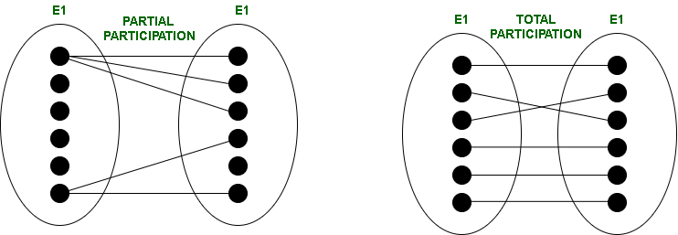

When each entity in an entity set participates in a relation, it is called Total Participation. However, when all entities in the given entity set do not participate in a relation, it is called Partial Participation.
Structural Constraints : Structural Constraints are also called Structural properties of a database management system (DBMS). Cardinality Ratios and Participation Constraints taken together are called Structural Constraints. The name constraints refer to the fact that such limitations must be imposed on the data, for the DBMS system to be consistent with the requirements.

Slide 51
The Structural constraints are represented by Min-Max notation. This is a pair of numbers(m, n) that appear on the connecting line between the entities and their relationships. The minimum number of times an entity can appear in a relation is represented by m whereas, the maximum time it is available is denoted by n. If m is 0 it signifies that the entity is participating in the relation partially, whereas, if m is either greater than or equal to 1, it denotes total participation of the entity

Slide 52
Weak Entity
A weak entity is an entity that cannot be uniquely identified by its attributes alone; therefore, it must use a foreign key in conjunction with its attributes to create a primary key
For example, a DRIVER_LICENSE entity cannot exist unless it is related to a PERSON entity, even though it has its own key (License_number) and hence this has become weak entity

Slide 53
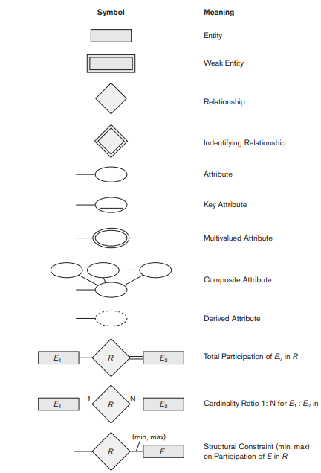
ER Diagram

